Slide 1

Single phase active filter for harmonic compensation
By
Ashok Saini
(Roll no. 24M1353)
Aditya Kumar
(Roll no. 24M1355)
M.Tech (1st year)
Subject – EN662
Under the guidance of
Prof. D. Venkatramanan
Department of Energy Science and Engineering
Indian Institute of Technology Bombay, Powai, 400076
May 2025

Slide 2
Problem statement
In 1-phase power systems,
Non-linear and reactive loads – Harmonic currents and reactive power
Conventionally, passive L-C filters were used.
But
Solution ?
Fixed compensation
Large size
Weight
Resonance
Losses
Noise
Active power filter

Slide 3
Introduction
Examples of non-linear loads – Variable speed drives, temperature controllers, electric furnaces, light controllers, solid state ac voltage regulators, SMPS and UPS.
Concern ?
Power quality issues,
Low efficiency of supply system
Poor power-factor
Destruction of other equipments due to excessive stresses
EMI problems
Active power filters (APF) – first introduced by Gyugi and Strycula.
APF connected in shunt mode with load through a filtering inductor.

Slide 4
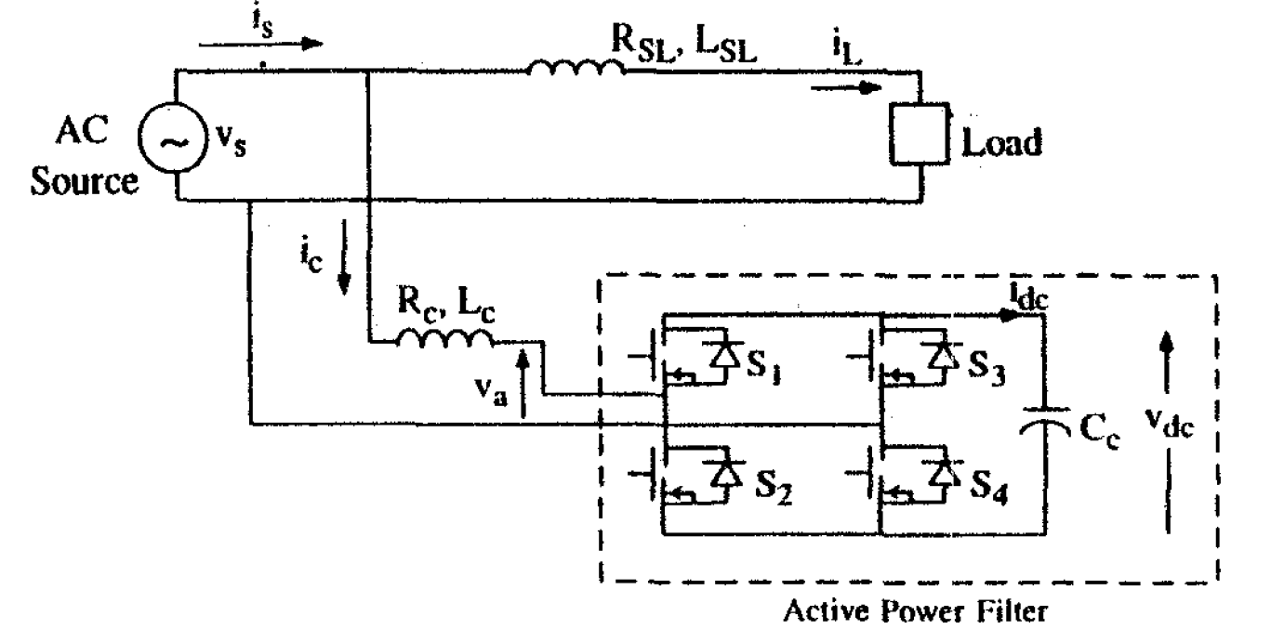
Power circuit Architecture
Fig 1 - Basic circuit of the Active power filter
https://doi.org/10.1109/PQ.1998.710359

Slide 5
Control scheme
Vr
Ism*
Reference current generator
is*
Current controller
PI controller
Vdc
is
u(t)
4 Gating signals
Unit vector generator
APF
Vs
Fig 2 - Control scheme of the APF
https://doi.org/10.1109/PQ.1998.710359

Slide 6
Analysis and model equations
A. Voltage controller
Ve(n) = Vr(n) - Vdc(n)
Vo(n) = Vo(n-1) + Kp{Ve(n) – Ve(n-1)} + Ki Ve(n)
where
Vdc = DC bus capacitor voltage
Vr = Set reference voltage
Ve(n) = Voltage error at n^{th} sample instant
Vo(n) = Output of PI voltage controller
B. Reference current generation
u(t) = vs/Vsm = sinωt
is*(t) = Ism*u(t) = Ism*sinωt
where
Vsm = Peak value of supply voltage
Ism*(t) = Peak estimated value of supply current
is* = Reference source current

Slide 7
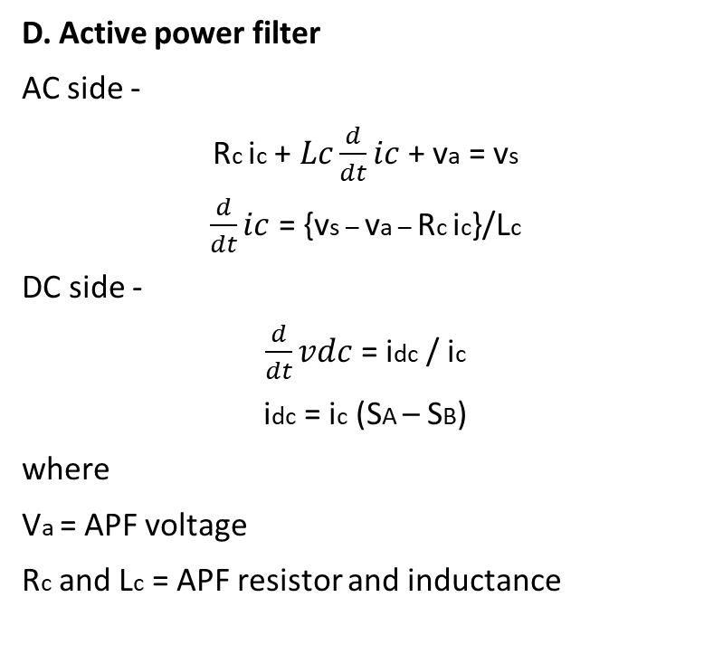
Analysis and model equations
C. Current controller
The carrierless PWM hysteresis current controller contributes to switching pattern of the APF devices.
va = Vdc(SA – SB)
where
SA = 1 ; S1 ON
SA = 0 ; S2 ON
SB = 1 ; S3 ON
SB = 0 ; S4 ON
D. Active power filter
AC side -
Rc ic +$Lc\frac{d}{dt}ic$ + va = vs
$\frac{d}{dt}ic$ = {vs – va – Rc ic}/Lc
DC side -
$\frac{d}{dt}vdc$ = idc / ic
idc = ic (SA – SB)
where
Va = APF voltage
Rc and Lc = APF resistor and inductance

Slide 8
Analysis and model equations
E. Rectifier with capacitive loading
R_{SL}i_{L} + L_{SL}di_{L}/dt + v_{L} = v_{S}
Pi_{L} = (v_{S} – v_{L} – R_{SL}i_{L})/L_{SL}
dv_{L}/dt = (i_{d} – i_{R})/C_{L}
where
R_{SL} and L_{SL} = Source impedance elements
i_{d} = Magnitude of i_{L}
i_{R} = Resistive DC load current
C_{L} = Load capacitor
v_{L} = voltage across load capacitor C_{L}

Slide 9
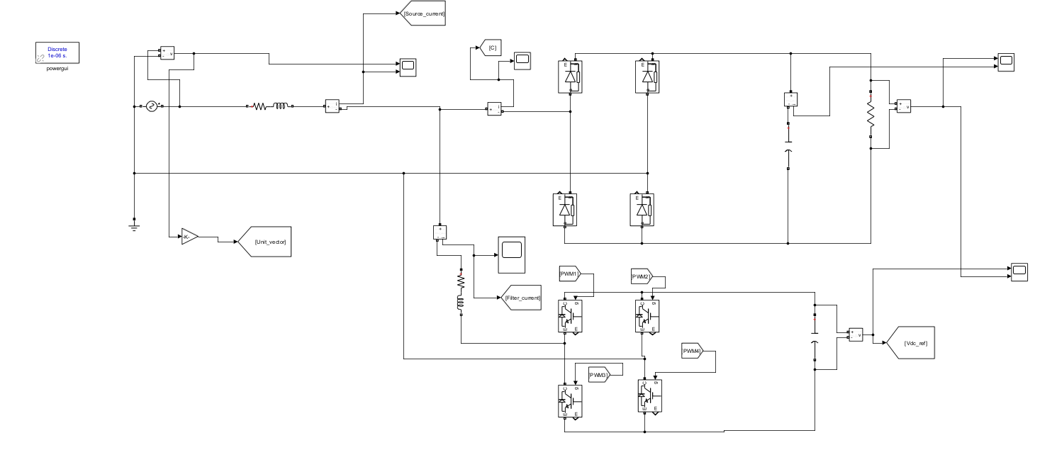
Circuit diagram with Active power filter
Fig 3 – Circuit diagram

Slide 10
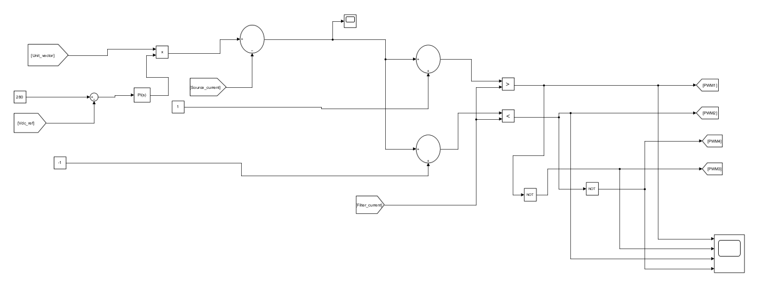
Control Architecture
Fig 4 – Control diagram

Slide 11
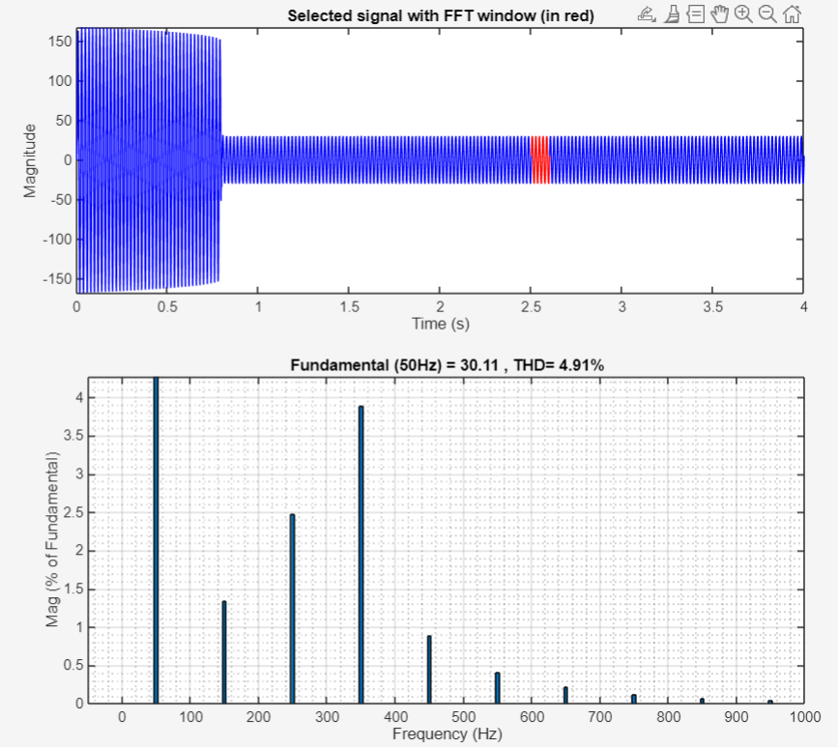
Waveforms
Fig 5 - Source current with THD (%)

Slide 12
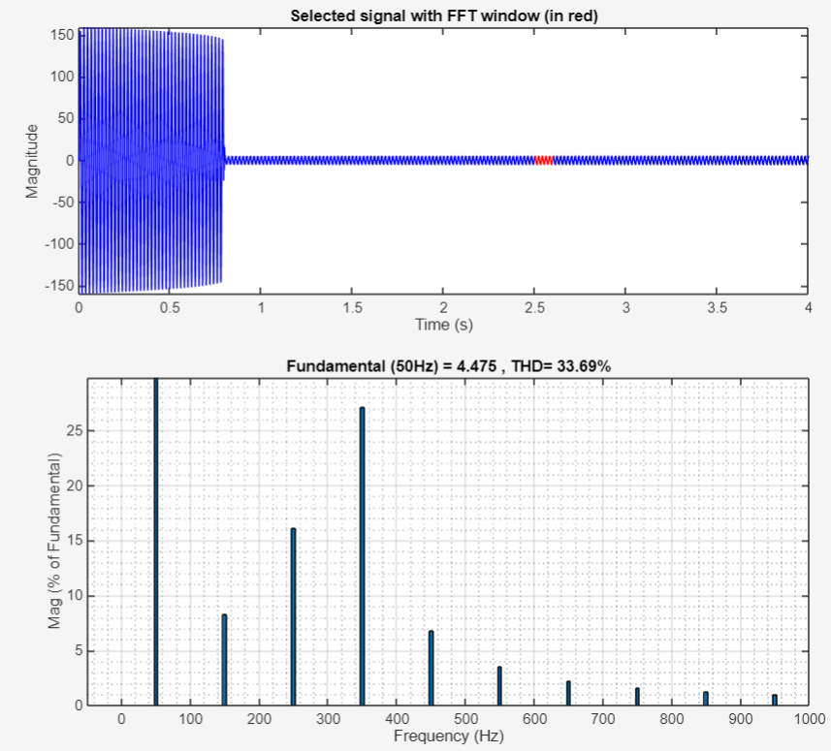
Waveforms
Fig 7 - Filter current with THD (%)

Slide 13
Design details
Supply : V_{s}(rms) = 220 V, f = 50 Hz,
Filter data : R_{c} = 0 ohm,
L_{c} = 4 mH,
C_{c} = 50 microF,
Series impedance : R_{SL} = 0.5 ohm,
L_{SL} = 1 mH,
Controller data : K_{P} = 0.45, K_{i} = 1
Load : R_{L} = 10 C_{L} = 10 microF

Slide 14
Conclusion
A simple and effective design of single-phase Active Power Filter (APF) is studied .
The APF uses:
A VSI with hysteresis current control
A PI-controlled DC bus with a small energy storage capacitor
Successfully compensated the harmonic currents
Simulation results show:
Reduced source current distortion
Enhanced supply system performance
It can further be extended for Grid connected PV systems also. (Already been implemented)

Slide 15
References
B. Singh, K. Al-Haddad and A. Chandra, "A universal active power filter for single-phase reactive power and harmonic compensation," Power Quality '98, Hyderabad, India, 1998.
J. R. Mattar, J. C. Strutz, R. Hausmann, S. V. G. Oliveira and A. Péres, "A single phase active filter as a harmonic compensator," 2013 Brazilian Power Electronics Conference, Gramado, Brazil, 2013.
B. L. Cortes, M. S. Horta, S. A. Claudio and G. V. M. Cardenas, "Single-phase active power filter for reactive power and harmonic compensation," 6th IEEE Power Electronics Congress. Technical Proceedings. CIEP 98 (Cat. No.98TH8375), Morelia, Mexico, 1998.

Slide 16


